Slide 1
Chatbots and Virtual Assistants
By Mete and Ravindu

Slide 2
What is a chatbot?
Notes:
A chatbot is a computer program that simulates and processes human conversation allowing humans to interact with digital devices as if they were communicating with a real person. This allows users to access support or information of a product based on pre set solutions and questions. In the event of a issue or question that is not pre determined the user is redirected to a human conversation that will allow the user to have their questions clarified or be helped in resolving an issue.

Slide 3
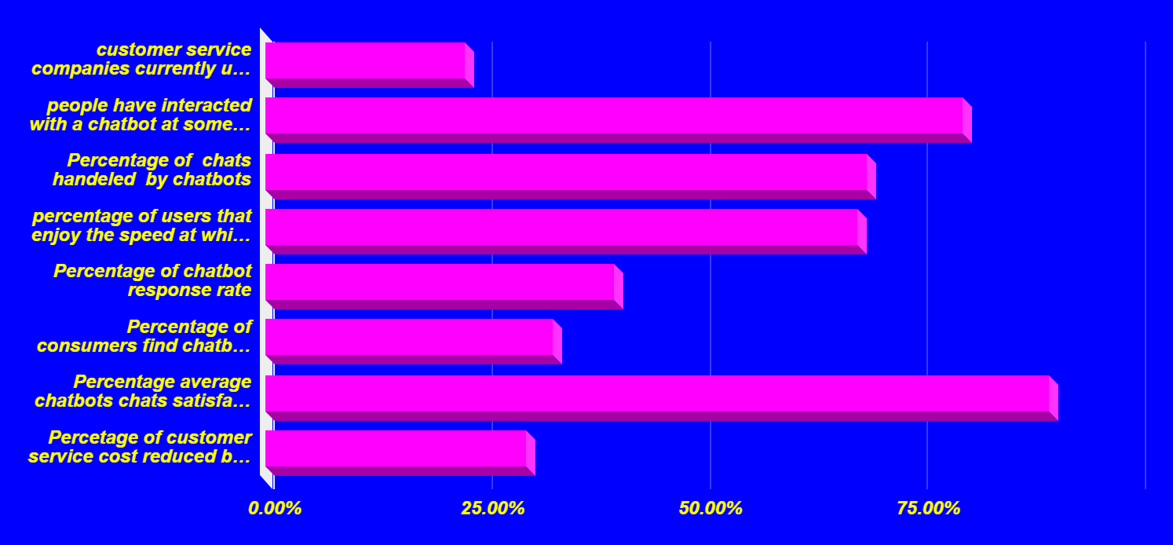
Predicted uses of chatbots

Slide 4
Why is our chatbot different?
Notes:
Our chatbot is different as it allows users to report their problems and try and fix it them self. We use collective data systems to see trends in issues so that we can directly fix the issue ourselves where possible making the user experience better.

Slide 5
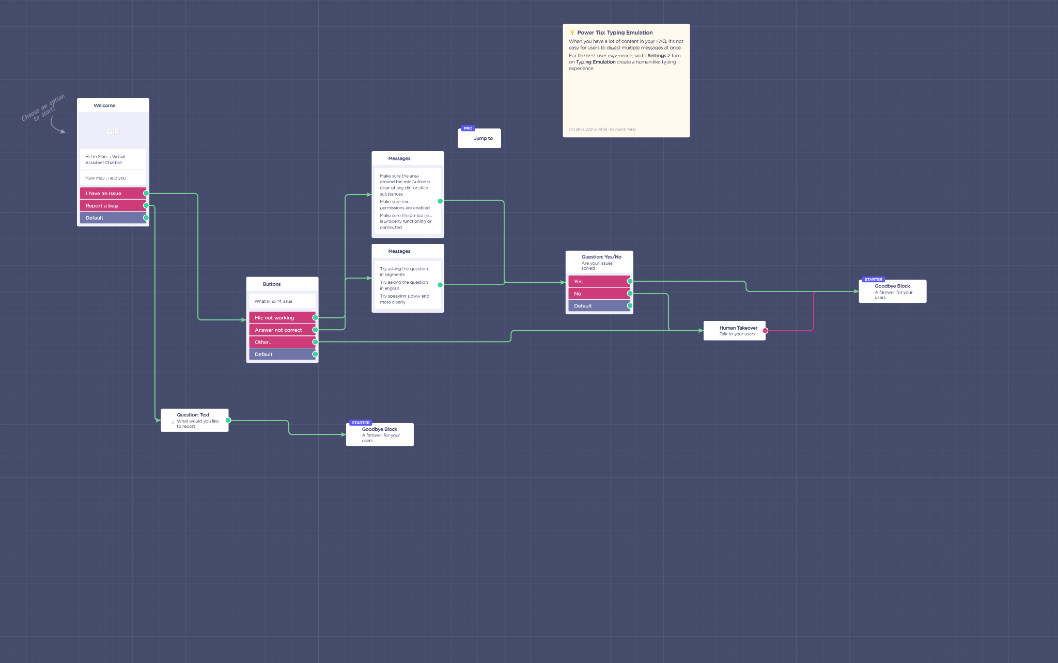
What is our chatbot

Slide 6
What is a virtual assistant?
Notes:
A virtual assistant, also known as a digital assistant is a software program whenever launched on a computer, responds to instructions submitted by a user by executing out the tasks that are defined in those instructions. The instructions can be given in a multitude of forms, including voice, text, and video. The virtual assistant can communicate both verbally and through text responses. Amazon's Alexa, Apple's Siri, Google Assistant, and Microsoft's Cortana are some of the most well-known virtual assistants now on the industry.

Slide 7
Why is our virtual assistant different?
Notes:
Our virtual assistant is nowhere near as known as Siri, Alexa, and Cortana, but we have created a virtual assistant that has superior features and benefits compared to the examples listed before. These examples consist of simplicity, user-friendliness, and does the exact same features as any other virtual assistant.

Slide 8

What are the pros of virtual assistants?
Notes:
Working with a virtual assistant provides a variety of benefits. The first benefit is organization which virtual assistants process work and outputs it smoothly. Another benefit would be that it could replace colleagues and employees as long as they are programmed correctly and efficiently. The final benefit would be it would assist with tasks that are hard for humans to do alone.

Slide 9
What are the cons of virtual assistants?
Notes:
There can be disadvantages to working with a virtual assistant. The first disadvantage is you need to train the virtual assistant in order for it to run smoothly and efficiently. The other drawback is that some virtual assistants are not very advanced and need a moderate to a significant amount of human supervision in order to get work done precisely. The final drawback is when the virtual assistant consists of technical issues, the virtual assistant could output false information.

Slide 10
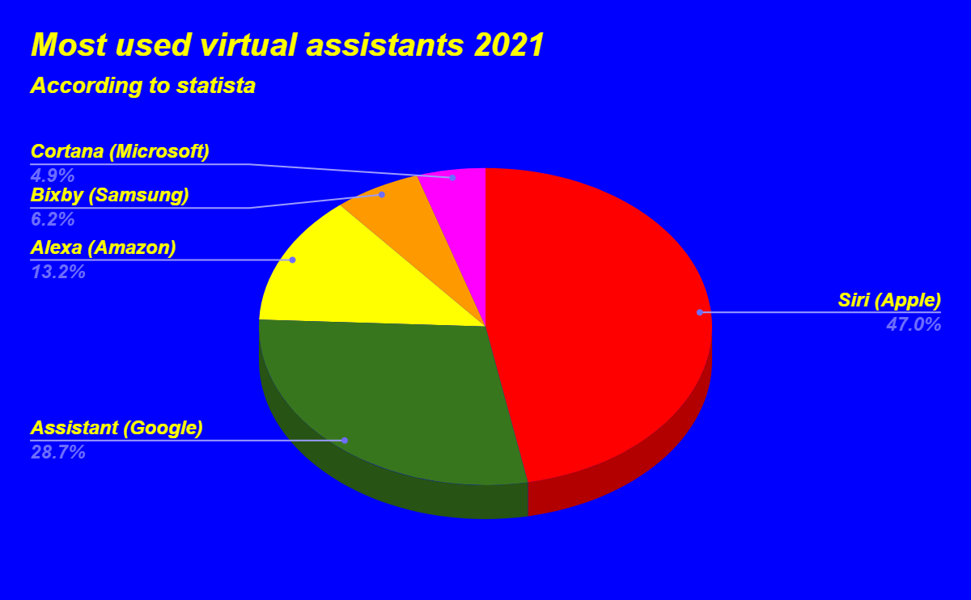
Most used virtual assistant(s)
Notes:
Siri, which is featured on Apple gadgets, has a sales volume of 45.65 percent in the United States, ranking it the top in the industry for virtual assistants on cell phones. This is regardless of the fact that Android is the leading popular OS for smartphones. Despite it being available on the vast majority of Android devices, the Google Assistant has only a 28.9 percent market share. In comparison, Samsung's Bixby scores even lower than Amazon's Alexa, a virtual assistant that is not native to any smartphone. Microsoft’s Cortana has the lowest percentage of virtual assistant users.

Slide 11
Live demo (Visual code)

Slide 12
Future Work (What is next)
Notes:
Mete: My goals for my future is to continue and enhance what I learned from this internship which is the starting point to creating my own virtual assistant. In the future, I want to study AI in university and develop virtual assistants for the law enforcement, military, smart homes, and perhaps private firms. I can propose benefits to militaries and police forces with AI because they can use the virtual assistants to track criminals, lock guns, turn on vehicles, enable different weapons, detect any threats, etc. I can also benefit smarthomes and private companies with a unique virtual assistant that could open the smartboards, tell the time, open certain files, access certain information, lock all doors, and turn on/off lights and/or windows.
Ravindu:

Slide 13
Thank you!

Slide 14
References (Mete)
https://www.uschamber.com/co/run/technology/what-is-virtual-assistant
https://www.techtarget.com/searchcustomerexperience/definition/virtual-assistant-AI-assistant#:~:text=Popular%20virtual%20assistants%20currently%20include,Phone%208.1%20and%20Windows%2010.
https://csuiteassistants.com/blog/pros-and-cons-of-virtual-assistants/

Slide 15
References (Ravindu)
https://www.oracle.com/chatbots/what-is-a-chatbot/
https://startupbonsai.com/chatbot-statistics/

